Slide 1

Doub less Living!
The Gospel of
LUKE
That you may have certainty!

Slide 2
Overcoming Rejection
Fired by the KC Star newspaper for lack of imagination and good ideas
Bombed at the Grand Ole Opry and told “stick to driving a truck”
Dropped out of Harvard to form a Tech company that failed
Didn’t speak until age 4, didn’t read until age 7, expelled from school
Entered the U.S. Army as a Captain but exited as a Private
Only sold only one painting during his lifetime to a friend for pittance
Rejected three times by USC School of Theater, Film and Television
Cut from his high school basketball team
Cartoon drawings rejected by his high school yearbook
Fired by WJZ-TV in Baltimore for getting too involved in the stories
Walt Disney
Elvis Presley
Bill Gates
Albert Einstein
Abraham Lincoln
Vincent van Gogh
Steven Spielberg
Michael Jordan
Charles Schultz
Oprah Winfrey

Slide 3
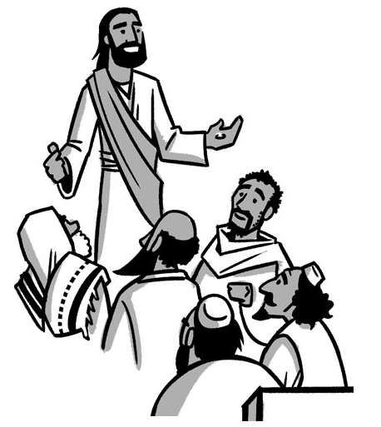
The Ministry of Jesus
Begins
^{Luke 4:14-21}
^{Luke 4:22-27}
^{Luke 4:28-30}
^{Luke 4:31-41}
^{Luke 4:42-44}

Slide 4
¹⁴ Then Jesus returned to Galilee in the power of the Spirit, and news about Him spread throughout the entire vicinity. ¹⁵ He was teaching in their synagogues, being acclaimed by everyone.
¹⁶ He came to Nazareth, where He had been brought up. As usual, He entered the synagogue on the Sabbath day and stood up to read. ¹⁷ The scroll of the prophet Isaiah was given to Him, and unrolling the scroll, He found the place where it was written:
¹⁸ The Spirit of the Lord is on Me, because He has anointed Me to preach good news to the poor. He has sent Me to proclaim freedom to the captives and recovery of sight to the blind, to set free the oppressed, ¹⁹ to proclaim the year of the Lord’s favor.
²⁰ He then rolled up the scroll, gave it back to the attendant, and sat down. And the eyes of everyone in the synagogue were fixed on Him. ²¹ He began by saying to them, “Today as you listen, this Scripture has been fulfilled.”
Reception
in Galilee
Luke 4:14-21
❶ How was Jesus received when He returned to Galilee? Why?
❷ Jesus was a pious Jew, how do we know that?
❸ How did the audience respond to Jesus’ reading?
❹ How did Jesus apply the passage He read from Isaiah?
❺ What 5 things did Jesus say the Spirit had anointed Him to do?

Slide 5
²² They were all speaking well of Him and were amazed by the gracious words that came from His mouth, yet they said, “Isn’t this Joseph’s son?”
²³ Then He said to them, “No doubt you will quote this proverb to Me: ‘Doctor, heal yourself. So all we’ve heard that took place in Capernaum, do here in Your hometown also.’”
²⁴ He also said, “I assure you: No prophet is accepted in his hometown. ²⁵ But I say to you, there were certainly many widows in Israel in Elijah’s days, when the sky was shut up for three years and six months while a great famine came over all the land. ²⁶ Yet Elijah was not sent to any of them—but to a widow at Zarephath in Sidon. ²⁷ And in the prophet Elisha’s time, there were many in Israel who had serious skin diseases, yet not one of them was healed—only Naaman the Syrian.”
Declaration
in Galilee
Luke 4:22-27
❶ How did the crowd respond to Jesus’ declaration?
❷ What difficulty were they having in accepting Jesus’ words?
❸ How did Jesus respond to their doubts and unbelief?
❹ What is significant about Jesus recounting the stories of Elijah and Elisha?

Slide 6
Rejection
in Galilee
²⁸ When they heard this, everyone in the synagogue was enraged. ²⁹ They got up, drove Him out of town, and brought Him to the edge of the hill that their town was built on, intending to hurl Him over the cliff. ³⁰ But He passed right through the crowd and went on His way.
Luke 4:28-30
❶ How did the crowd respond when Jesus reminded them about previous times when God’s blessing had been offered to Gentiles because of their unbelief?
❷ How did the people express their anger at Jesus’ message?
❸ How did Jesus respond? Why?

Slide 7
³¹ Then He went down to Capernaum, a town in Galilee, and was teaching them on the Sabbath. ³² They were astonished at His teaching because His message had authority. ³³ In the synagogue there was a man with an unclean demonic spirit who cried out with a loud voice, ³⁴ “Leave us alone! What do You have to do with us, Jesus—Nazarene? Have You come to destroy us? I know who You are—the Holy One of God!”
³⁵ But Jesus rebuked him and said, “Be quiet and come out of him!” And throwing him down before them, the demon came out of him without hurting him at all. ³⁶ Amazement came over them all, and ⌊they⌋ kept saying to one another, “What is this message? For He commands the unclean spirits with authority and power, and they come out!” ³⁷ And news about Him began to go out to every place in the vicinity.
³⁸ After He left the synagogue, He entered Simon’s house. Simon’s mother-in-law was suffering from a high fever, and they asked Him about her. ³⁹ So He stood over her and rebuked the fever, and it left her. She got up immediately and began to serve them.
⁴⁰ When the sun was setting, all those who had anyone sick with various diseases brought them to Him. As He laid His hands on each one of them, He would heal them. ⁴¹ Also, demons were coming out of many, shouting and saying, “You are the Son of God!” But He rebuked them and would not allow them to speak, because they knew He was the Messiah.
Ministry
in Capernaum
Luke 4:31-41
❶ Where was Capernaum?

Slide 8
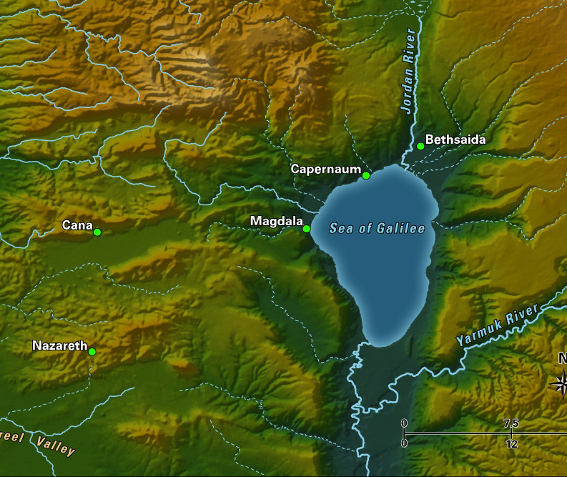
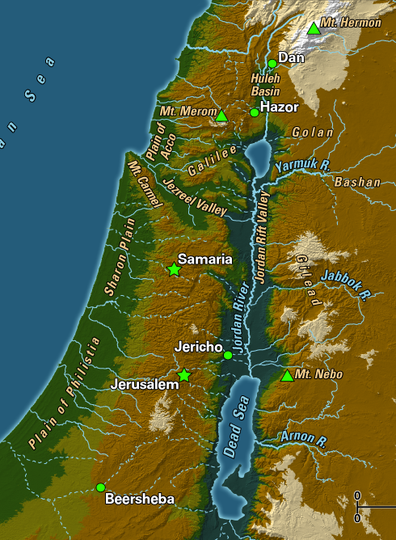
Galilee - Jesus’ Home Base

Slide 9
³¹ Then He went down to Capernaum, a town in Galilee, and was teaching them on the Sabbath. ³² They were astonished at His teaching because His message had authority. ³³ In the synagogue there was a man with an unclean demonic spirit who cried out with a loud voice, ³⁴ “Leave us alone! What do You have to do with us, Jesus—Nazarene? Have You come to destroy us? I know who You are—the Holy One of God!”
³⁵ But Jesus rebuked him and said, “Be quiet and come out of him!” And throwing him down before them, the demon came out of him without hurting him at all. ³⁶ Amazement came over them all, and they kept saying to one another, “What is this message? For He commands the unclean spirits with authority and power, and they come out!” ³⁷ And news about Him began to go out to every place in the vicinity.
³⁸ After He left the synagogue, He entered Simon’s house. Simon’s mother-in-law was suffering from a high fever, and they asked Him about her. ³⁹ So He stood over her and rebuked the fever, and it left her. She got up immediately and began to serve them.
⁴⁰ When the sun was setting, all those who had anyone sick with various diseases brought them to Him. As He laid His hands on each one of them, He would heal them. ⁴¹ Also, demons were coming out of many, shouting and saying, “You are the Son of God!” But He rebuked them and would not allow them to speak, because they knew He was the Messiah.
Ministry
in Capernaum
Luke 4:31-41
❶ Where was Capernaum?
❷ What did the demons say about Jesus, how did he respond and why?
❸ How was Jesus’ reputation affected by these acts?
❹ What was different about Capernaum and Nazareth?

Slide 10
Jesus’
Mission Statement
⁴² When it was day, He went out and made His way to a deserted place. But the crowds were searching for Him. They came to Him and tried to keep Him from leaving them. ⁴³ But He said to them, “I must proclaim the good news about the kingdom of God to the other towns also, because I was sent for this purpose.” ⁴⁴ And He was preaching in the synagogues of Galilee.
❶ How did Jesus begin the next day?
❷ When the crowd found Jesus, what did they try to convince Him to do?
❸ What did Jesus say was His mission?
❹ What is the good news about the kingdom of God?
Luke 4:42-44

Slide 11
The Pattern of
Jesus’
Ministry
Jesus went to the Jews
They rejected Him and His message
He told them of Gentile participation in the kingdom
They were enraged and some Jews wanted to kill Him
He was not killed until the proper time, when He chose to die

Slide 12
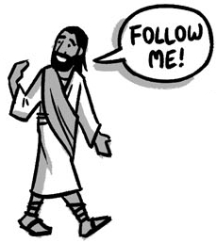
Jesus Come Follow Me!
Luke 5

